Slide 1
CAPSTONE PROJECT
Travel App
Submitted by:- Ashee Goud

Slide 2
Content
Introduction
Requirements
Flow Chart
Working Modules
Summary

Slide 3
Requirements
Created an application that meets these requirements:
Each employee must submit an electronic request in the system for future travel.
Each request includes a list of estimated expenses for airfare, hotel, rental car, and so on.
Each request must be approved by the employee’s manager, and all out-of-state travel must be approved by a travel coordinator.
Managers need reports and dashboards to track key travel request trends and KPIs.
In addition, employees and managers must be able to access their travel requests, approvals, and dashboards via mobile device.

Slide 4
Introduction
Project Background there are several ways to adjust the user interface in your Salesforce org to meet your needs.
Travel App is an Application where user can plan your trip and user can select their specific date according to there requirements it includes reports and dashboards and here the user can also edit and modify the trip in the way they want work on salesforce and to build this app we have to know apex code and administration to complete this application we have created Software with the help of salesforce the name of that software is travel app. In app we created tab Report, Dashboard, Travel approval and Department. Each tab have different functionality

Slide 5
Flow Chart
Login
Travel App
Click On Tab
Fill Out Form
Click on Submit
Plan Your Trip

Slide 6
Module 1
This project module focuses on the non-coding approach to modifying the user interface, as you customize an app that tracks company travel.
Created a custom application that meets these requirements:
Build a Lightning app, add tabs, and customize page layouts.
Created custom objects and fields for the app.
Defined relationships between objects. Import data.
Created Travel Approvals, Travel Expenses & Users. Customize List views, Page Layouts , Related Lists. Setup Approval settings for User. Enable Chatter on the Travel Approval Object.

Slide 7
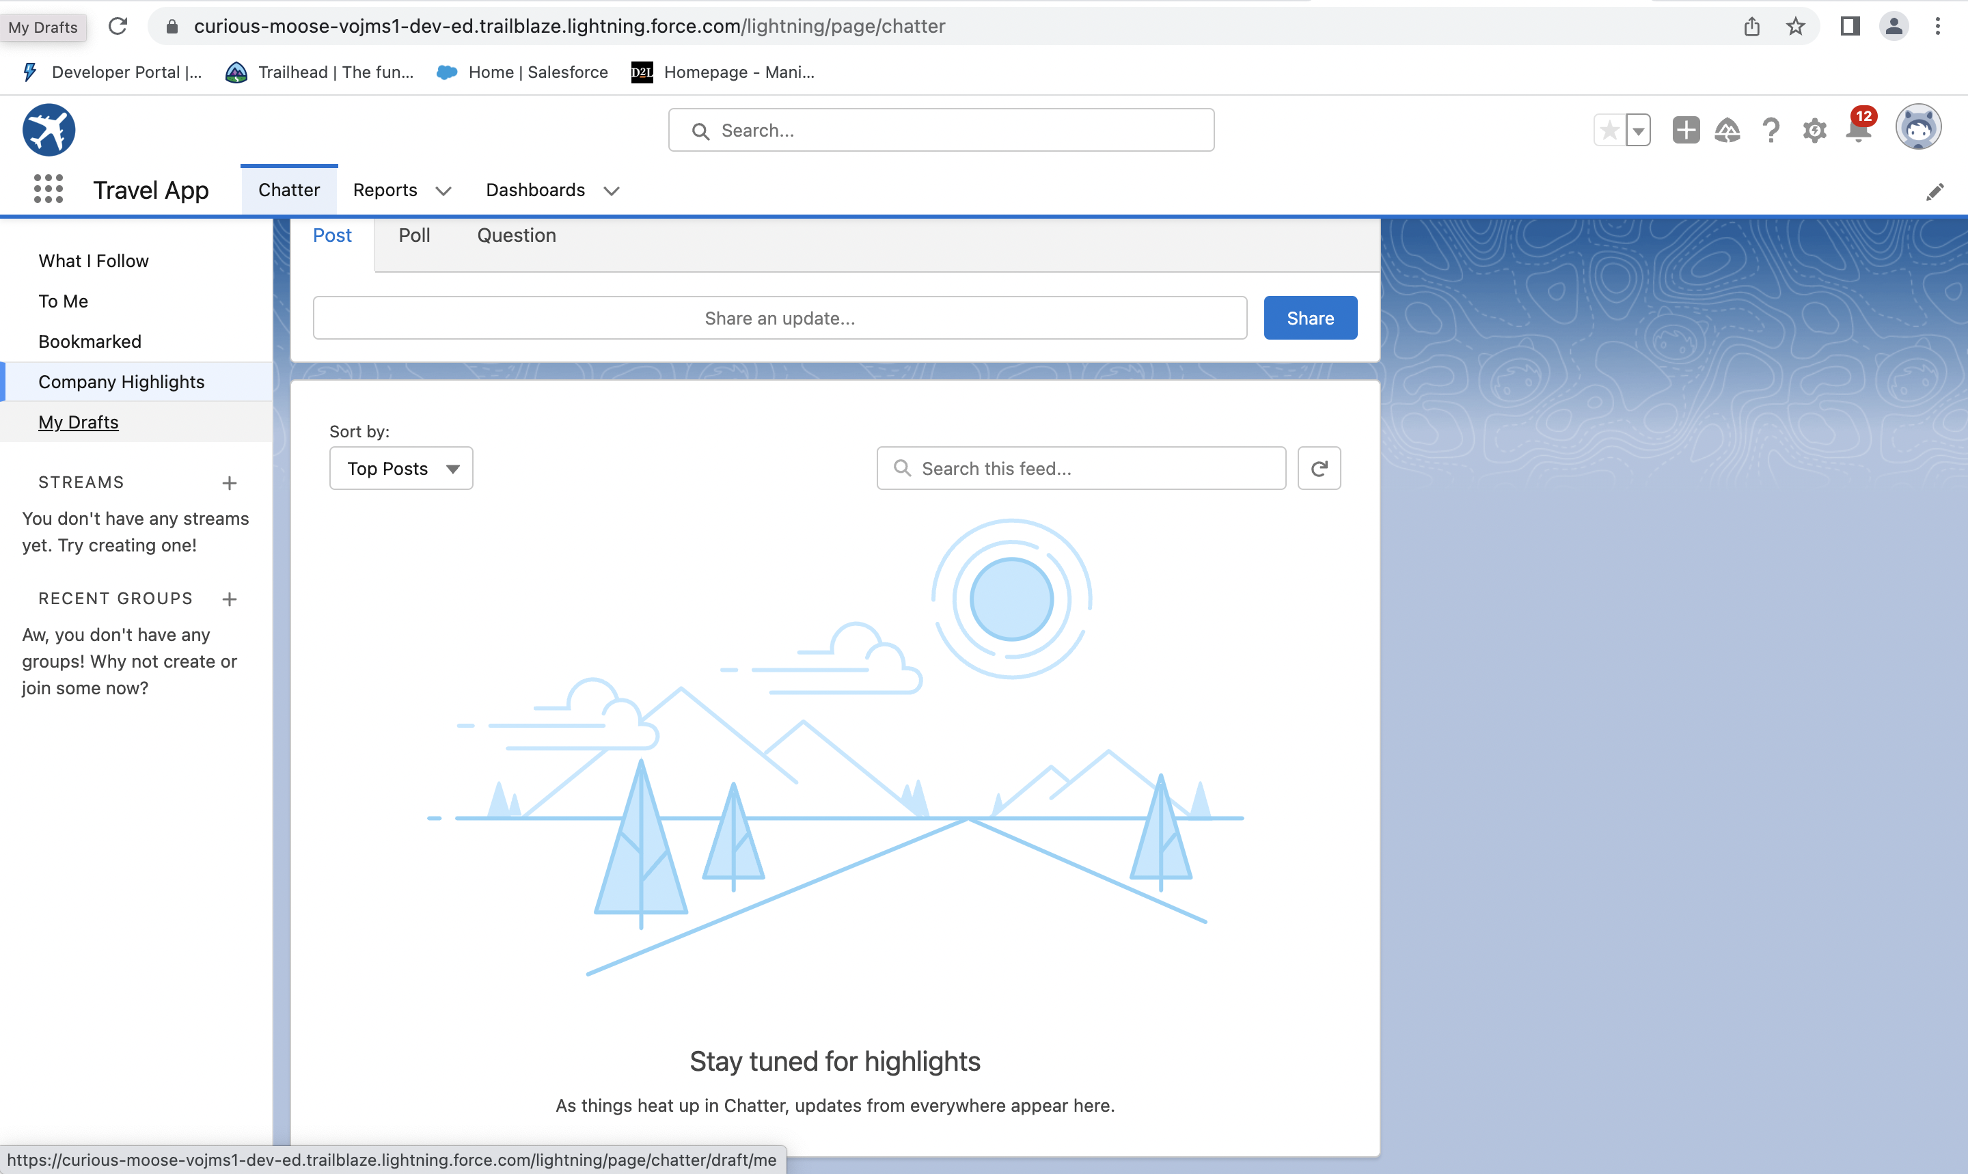

Slide 8
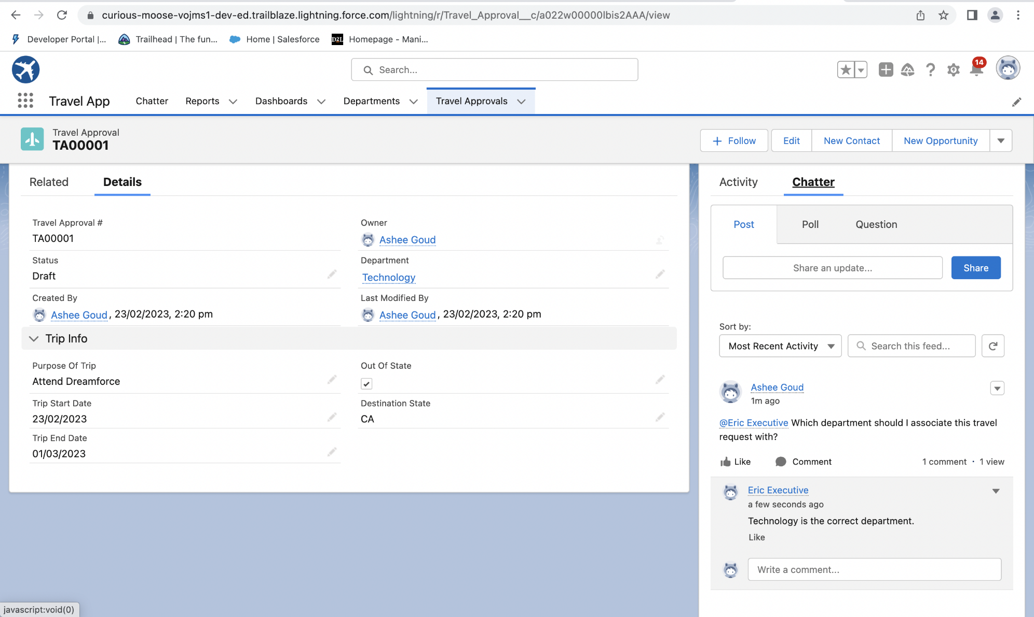

Slide 9
Module 2
This project module focuses on the Automation and Analytics Tools to enhance your custom App development.
Add Business logic & Analytics to the Travel Approval App.
Added Business logics Reports and Dashboards to:
Enforce data integrity with validation rules. Define business logic using roll-up summary and formula fields Automate business processes with Flows. Define Approval Process for Travel Approval App. Create Reports to analyze Travel Approvals. Build Dashboards for Travel Approval Management.

Slide 10
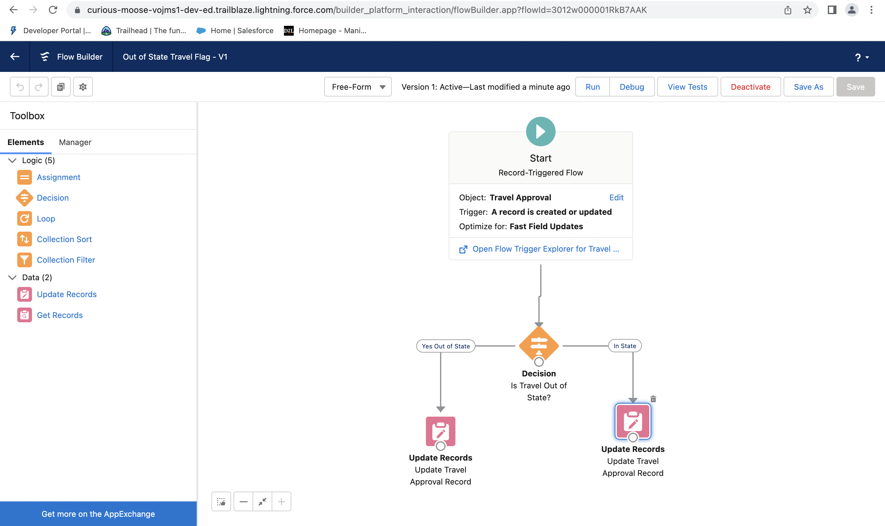

Slide 11
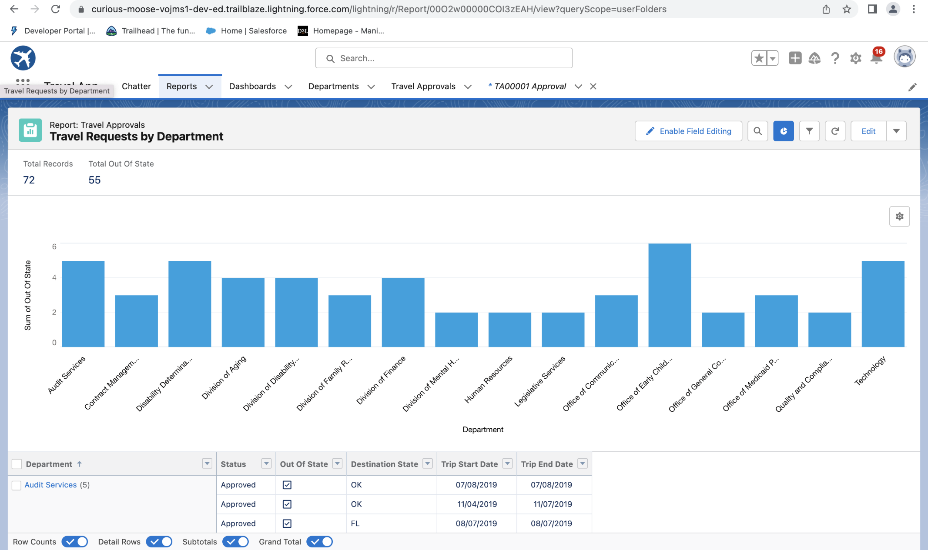

Slide 12
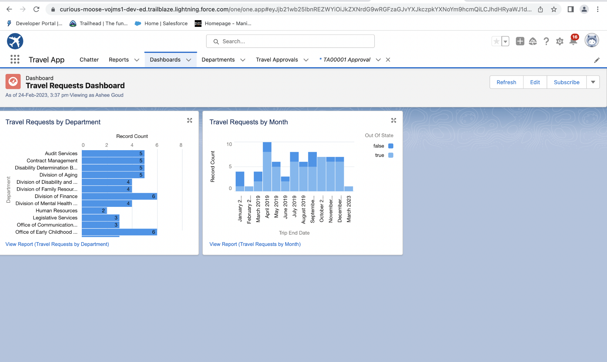

Slide 13
Module 3
This project module focuses on the coding approach to extend the functional capabilities of your custom App.
Write and executed codes from Anonymous window. Demonstrated the use of Data types & Variables. Demonstrated the use of Control Flow Statement. Defined relationships between objects. Data Manipulation using DML. Querying the Data base using SOQL. Created Apex Classes, Objects & Interfaces
Apex Triggers
Test Classes. Created Visual Force Pages.

Slide 14
Software requirement:-
Platform:- Salesforce Dev Edition
Browser:- Chrome/Safari/Mozilla etc
Ram:- 4GB and above
OS:- windows/linux/Mac

Slide 15
Summary:-
This application focuses on the simple user interface and User can easily access the application. It is user friendly User can understand and perform action in easy way There are lot of tab to do different action Make it according to need of user and can be accessible easily, here user can easily edit and modify and update the data according to their need.

Slide 16
Thank you

